Slide 1
Git and Jenkins

Slide 2
Git and Jenkins
First off you need the Git plugin from the Jenkins plugin manager
Once that is successfully installed you will see an additional option when you create a new job under “Source Code Management” called Git

Slide 3
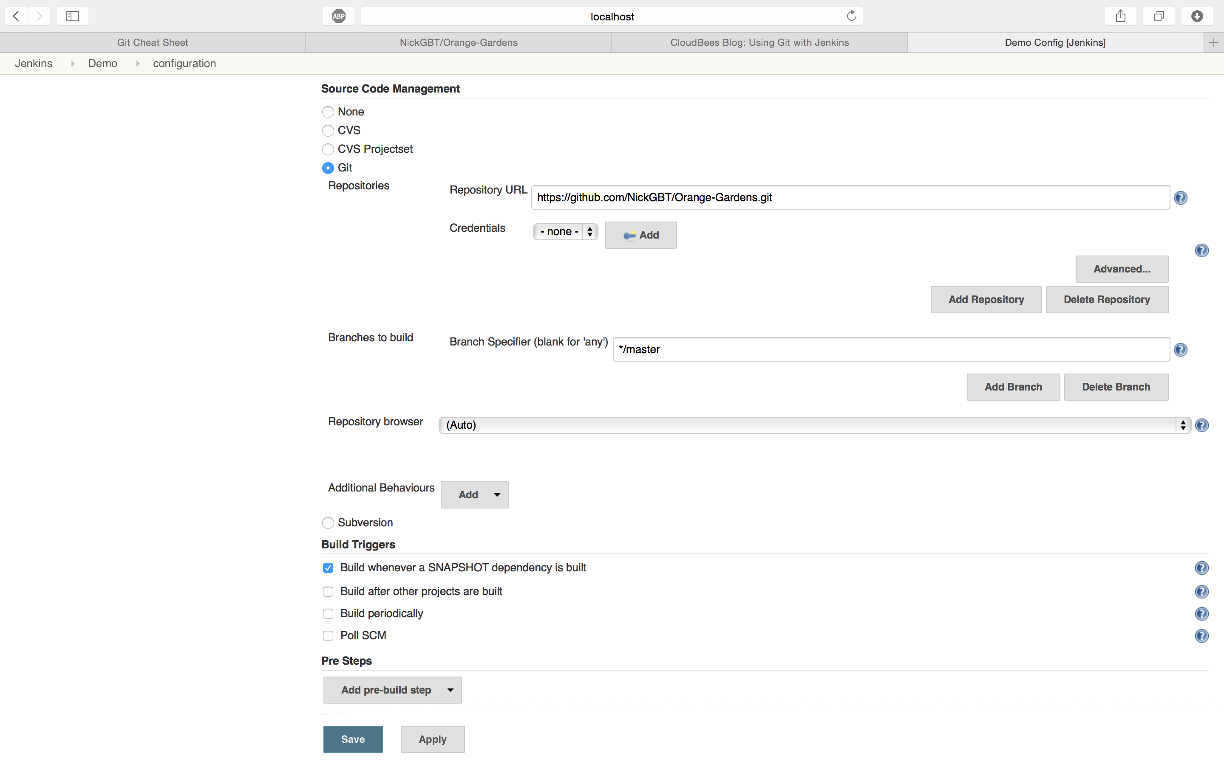
Here you can configure your Git repository

Slide 4
Advanced Configuration
There are a number of options that can be configured on the build. For example, you can set your Git username and email so that the repository on GitHub will track your commits properly.

Slide 5
Advanced Configuration Part 2
This plugin can be used to implement a pre-commit feature wherein commits are merged into a stable branch only if builds happen successfully on a development branch.

